Slide 1
HALL MANAGEMENT SYSTEM
MOCK UI
Presented by
Noshin Ulfat(1705089)

Slide 2
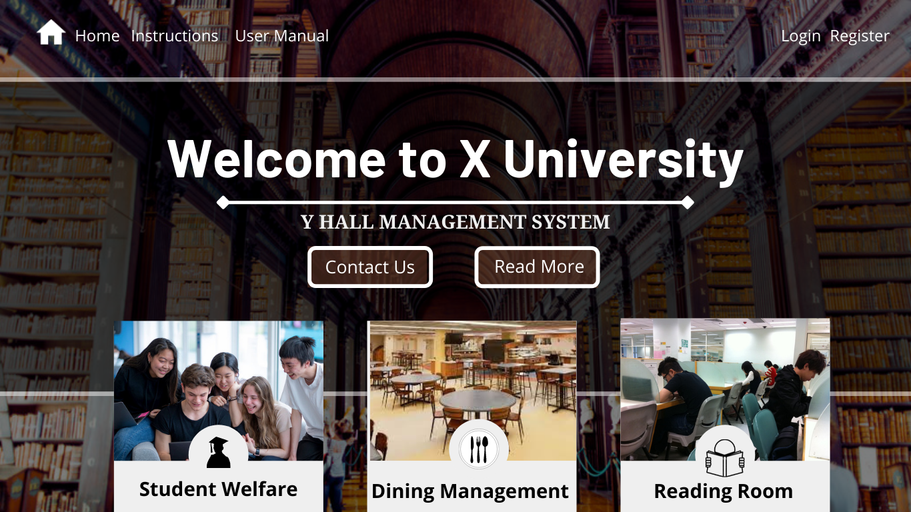
Home Page

Slide 3
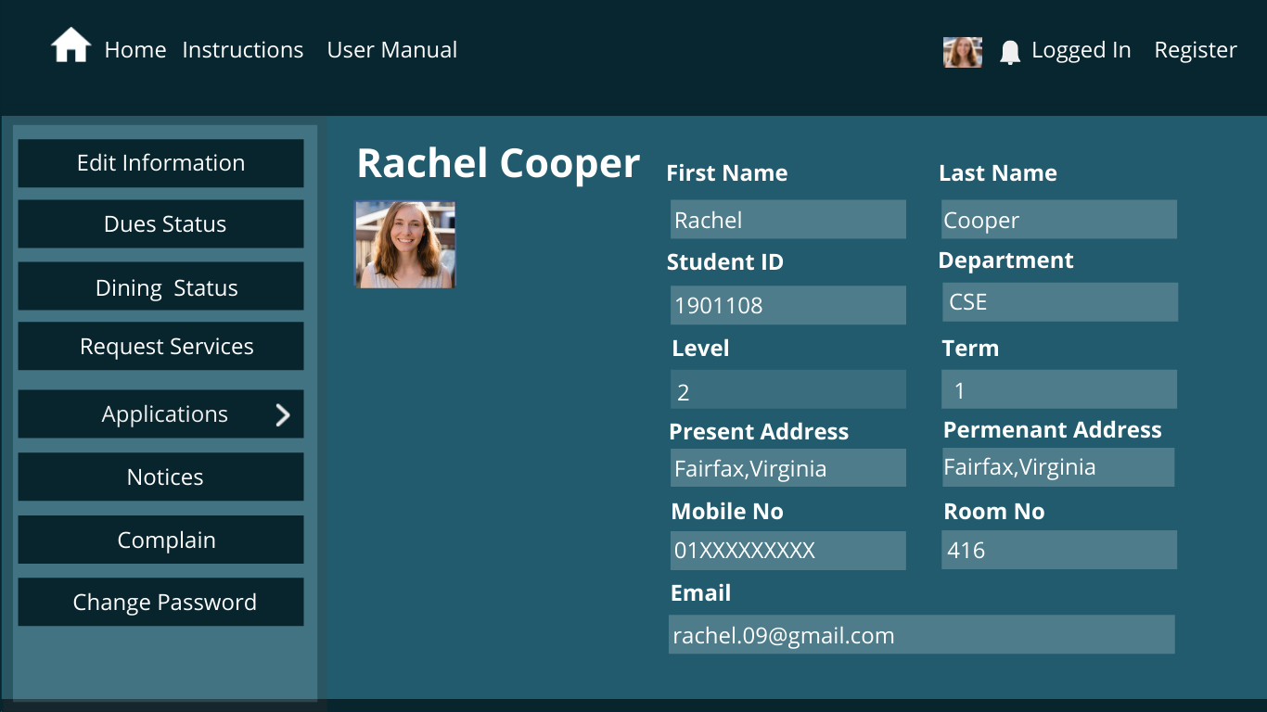
Student Page

Slide 4
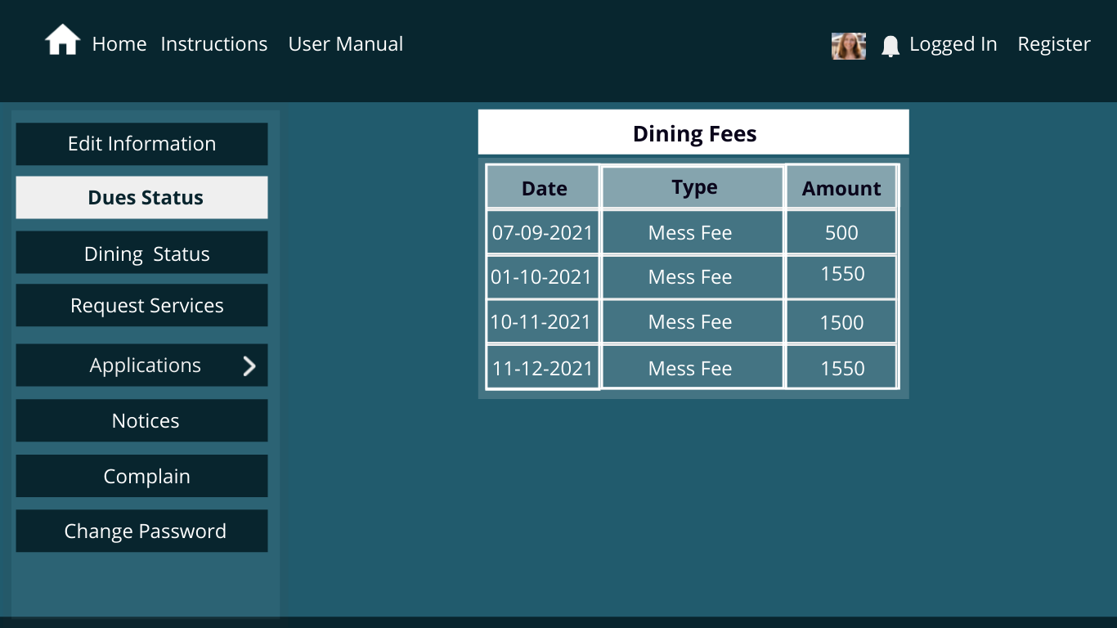
Dues Status

Slide 5
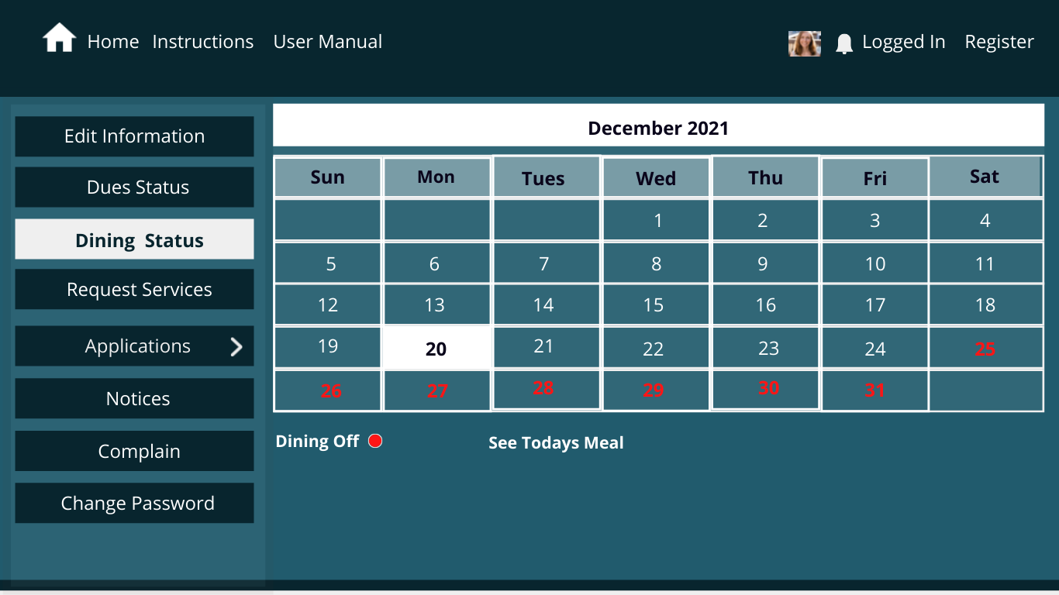
Dining Page of Regular Students

Slide 6
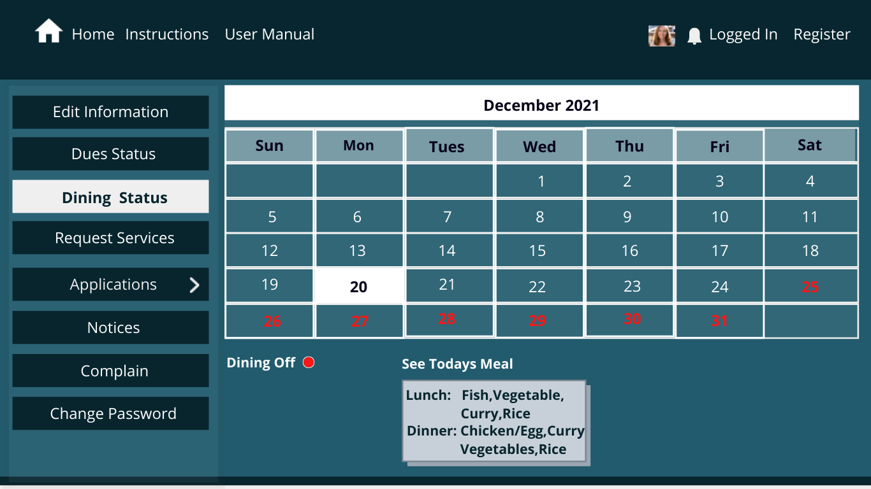
Dining Page of Regular Students

Slide 7
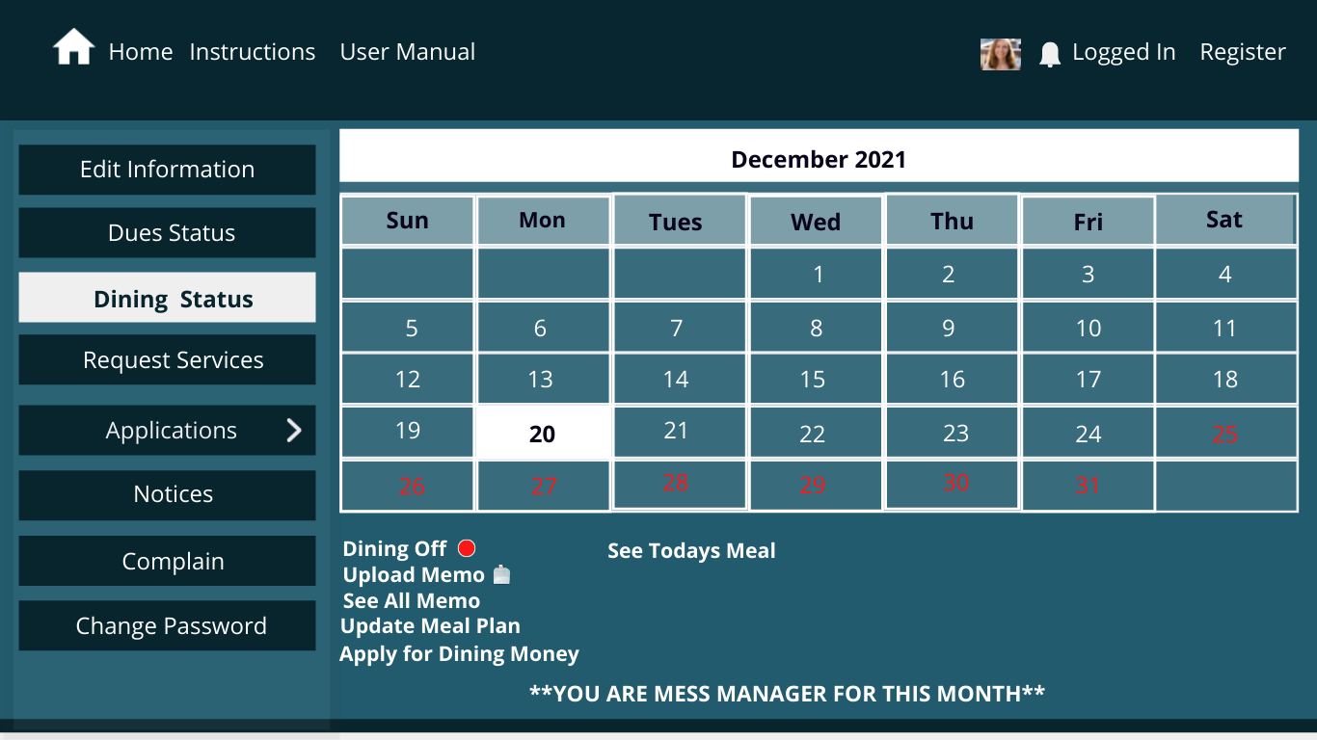
Dining Page of Mess Manager

Slide 8
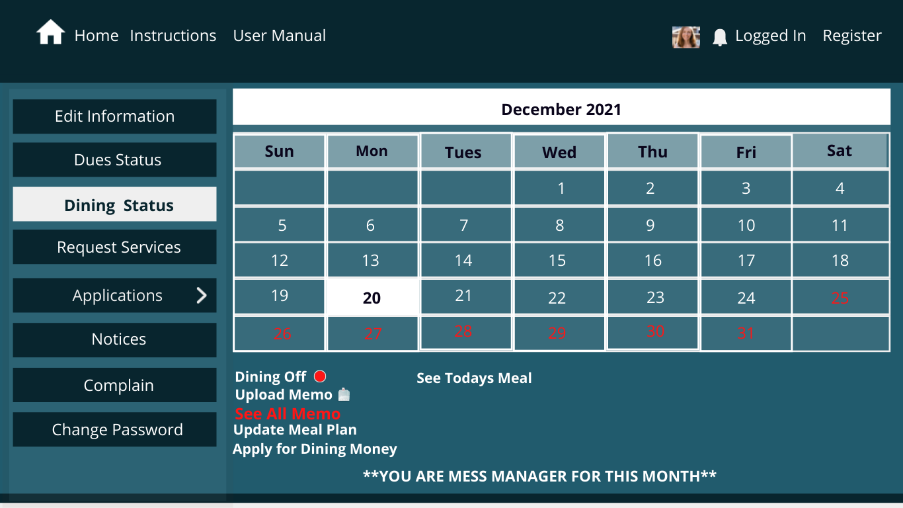
Dining Page of Mess Manager

Slide 9
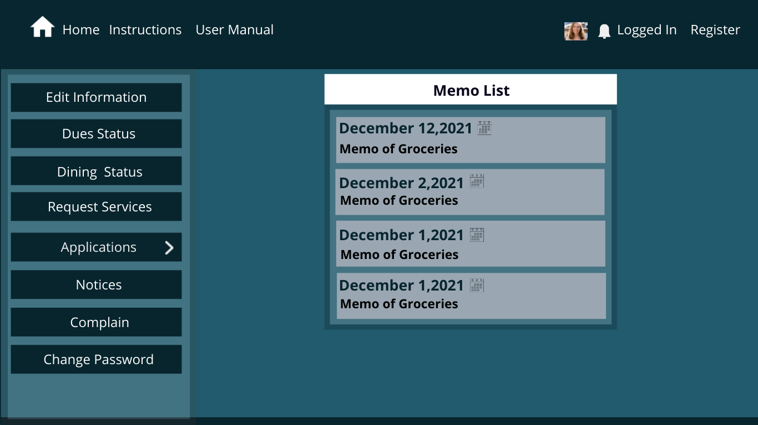
Dining Page of Mess Manager

Slide 10
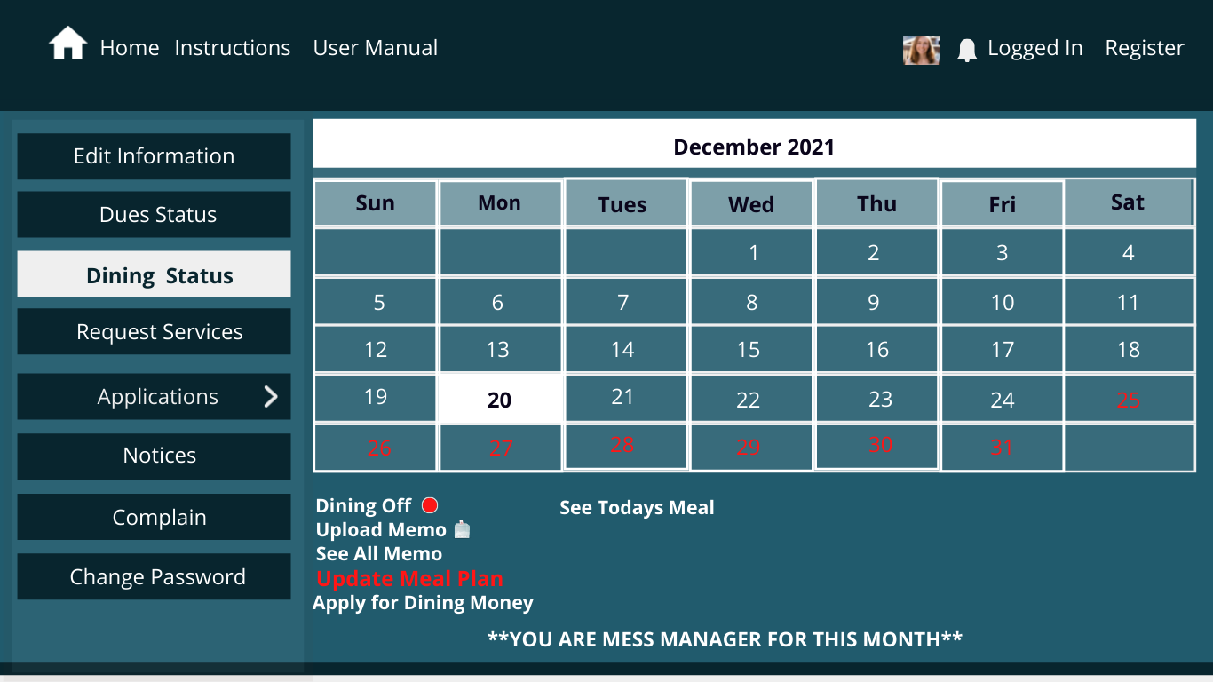
Dining Page of Mess Manager

Slide 11
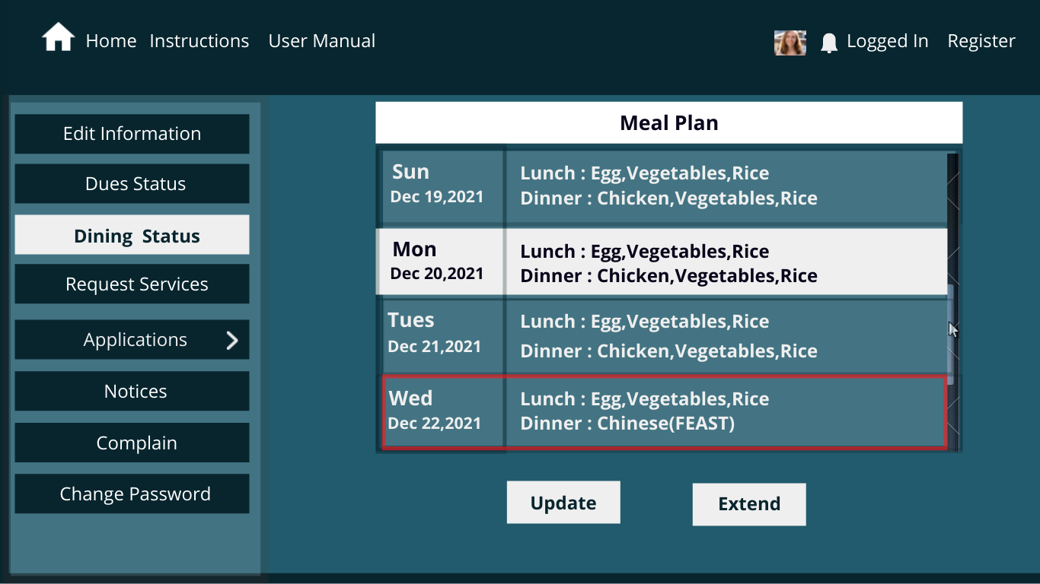
Dining Page of Mess Manager

Slide 12
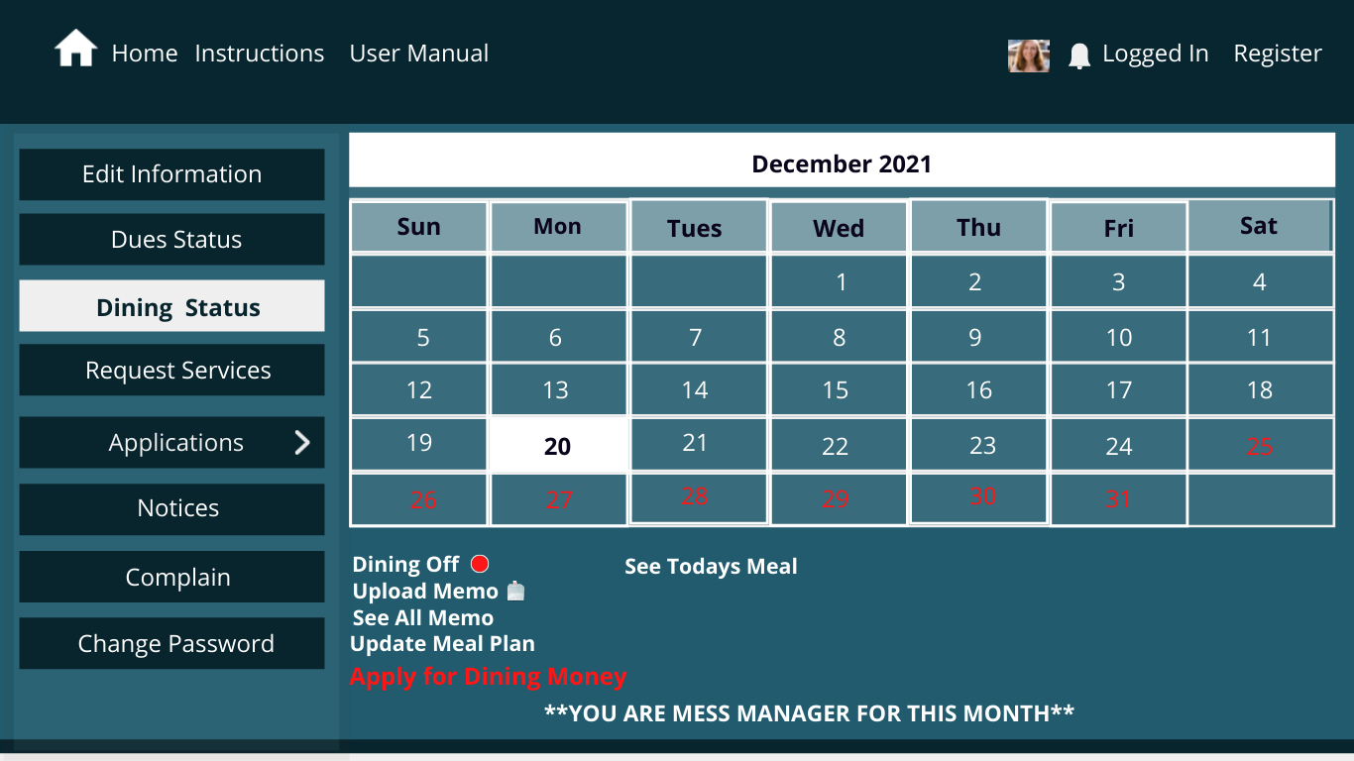
Dining Page of Mess Manager

Slide 13
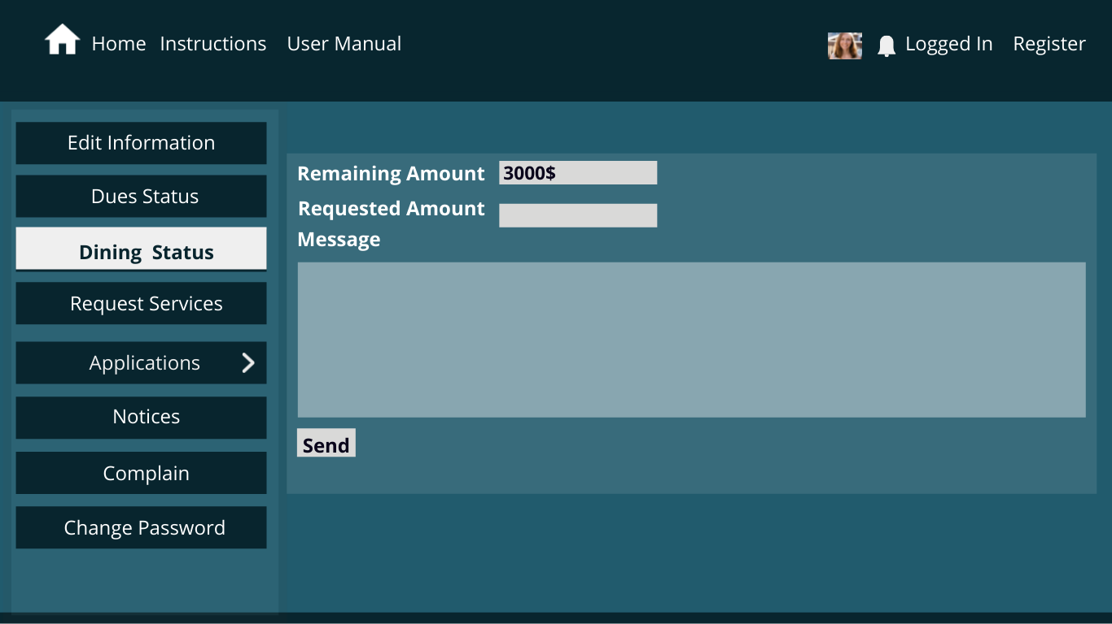
Dining Page of Mess Manager

Slide 14
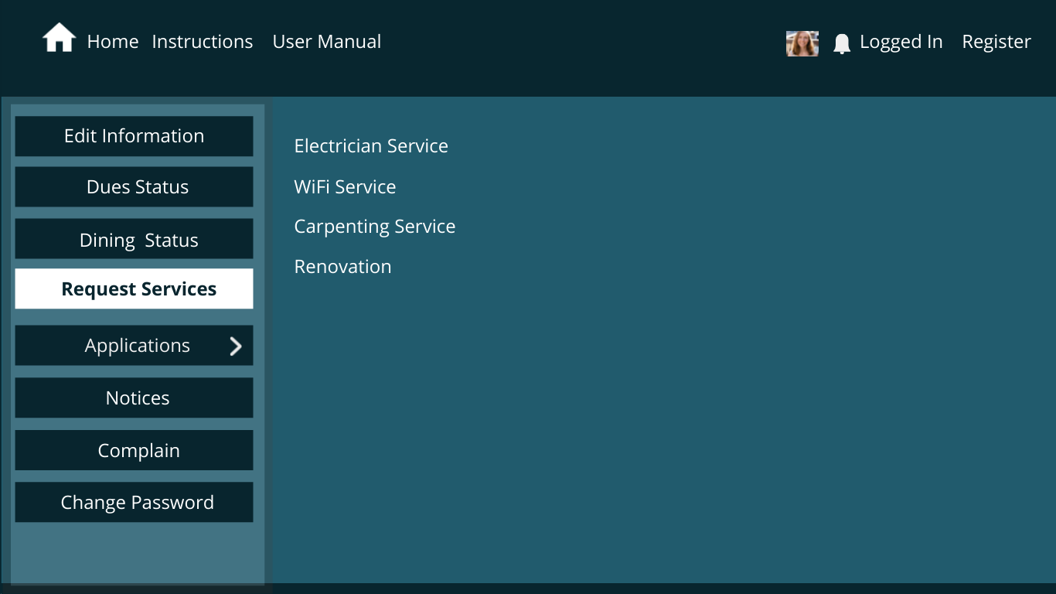
Request Service

Slide 15
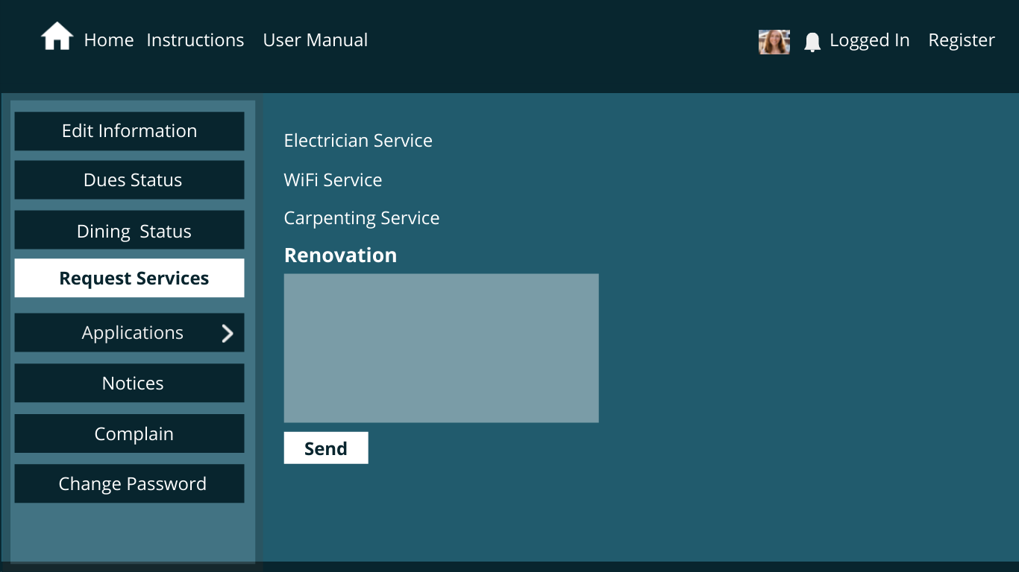
Request Service

Slide 16
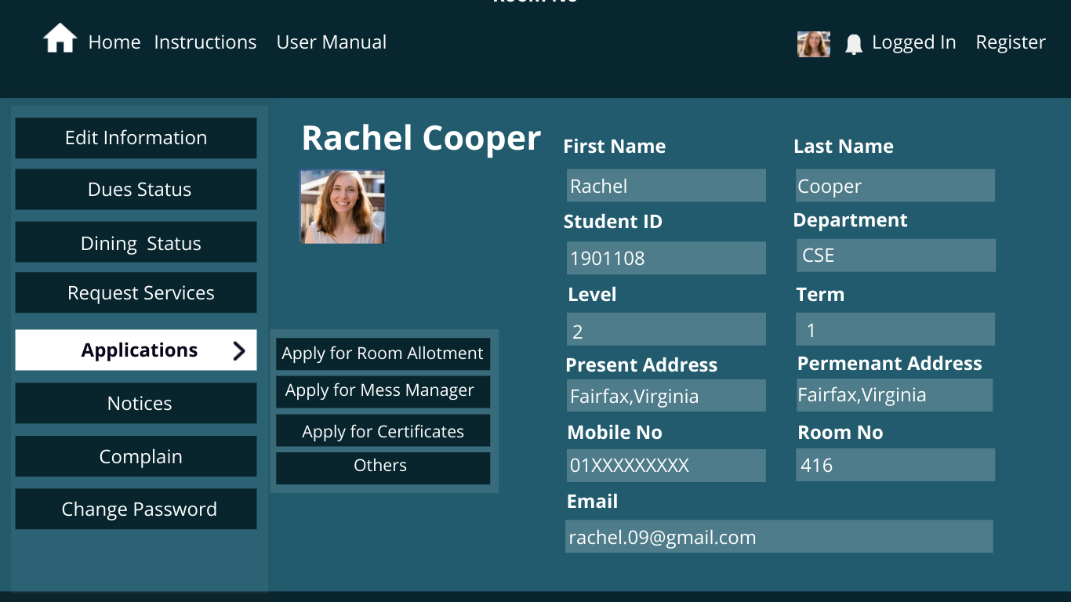

Student Applications

Slide 17
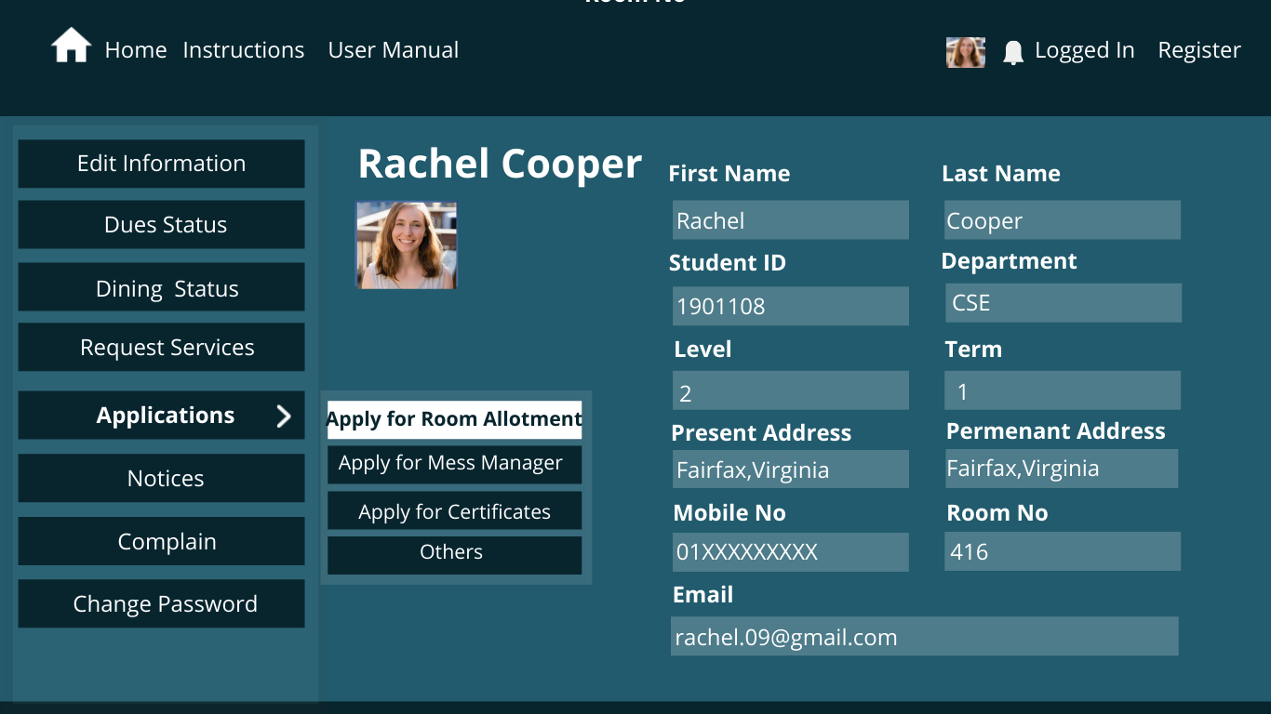
Student Applications

Slide 18
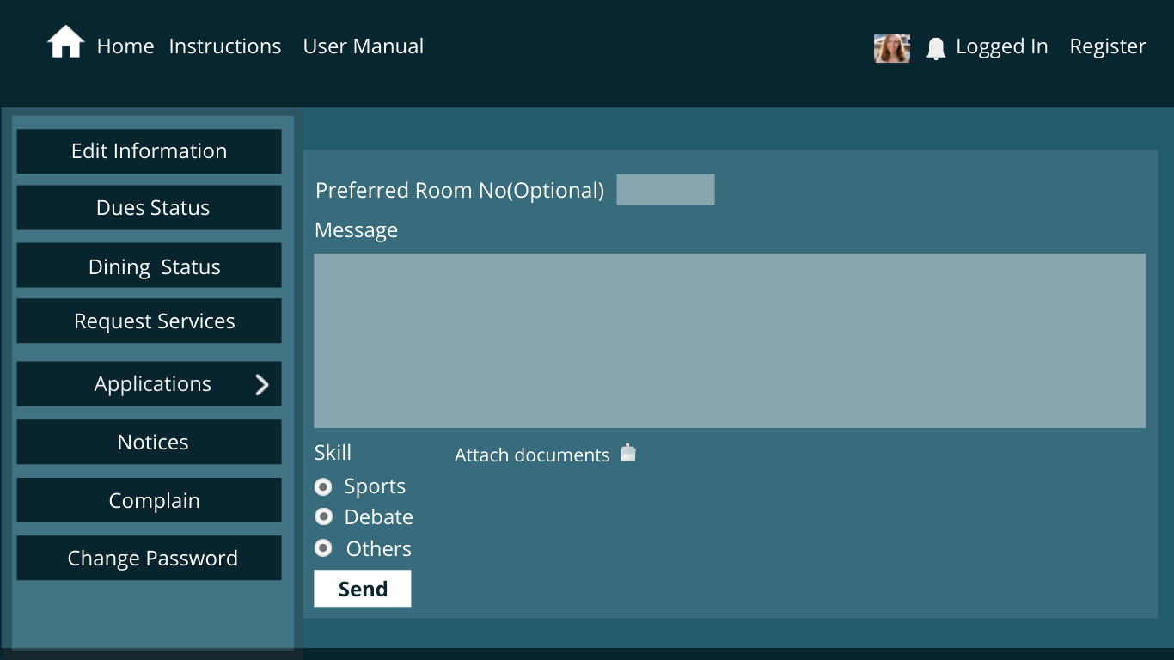
Student Applications

Slide 19
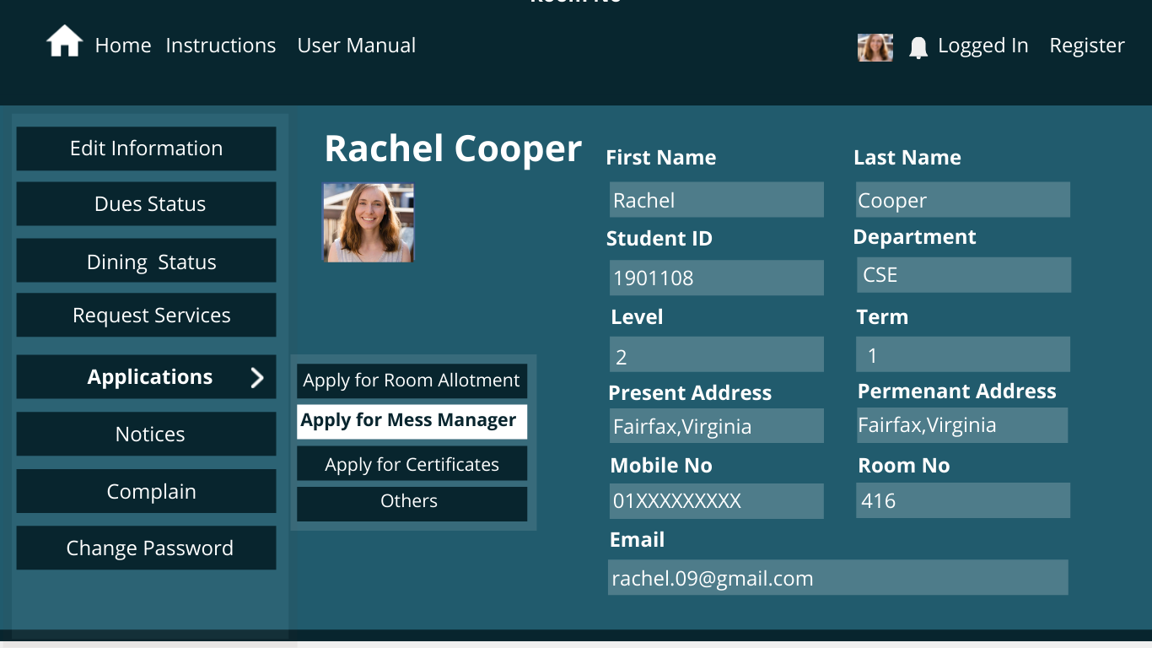
Student Applications

Slide 20
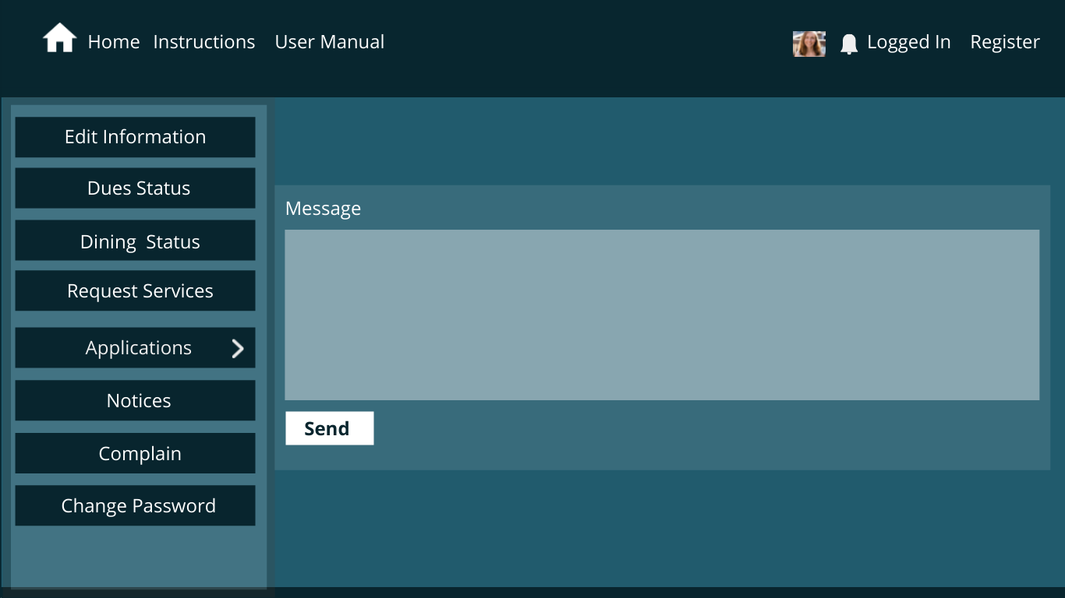
Student Applications

Slide 21
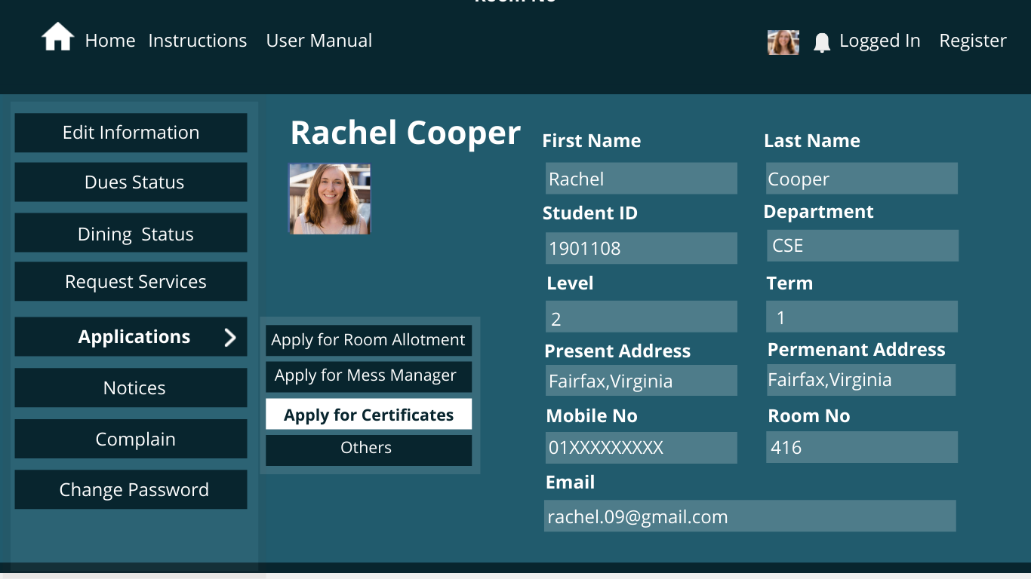
Student Applications

Slide 22
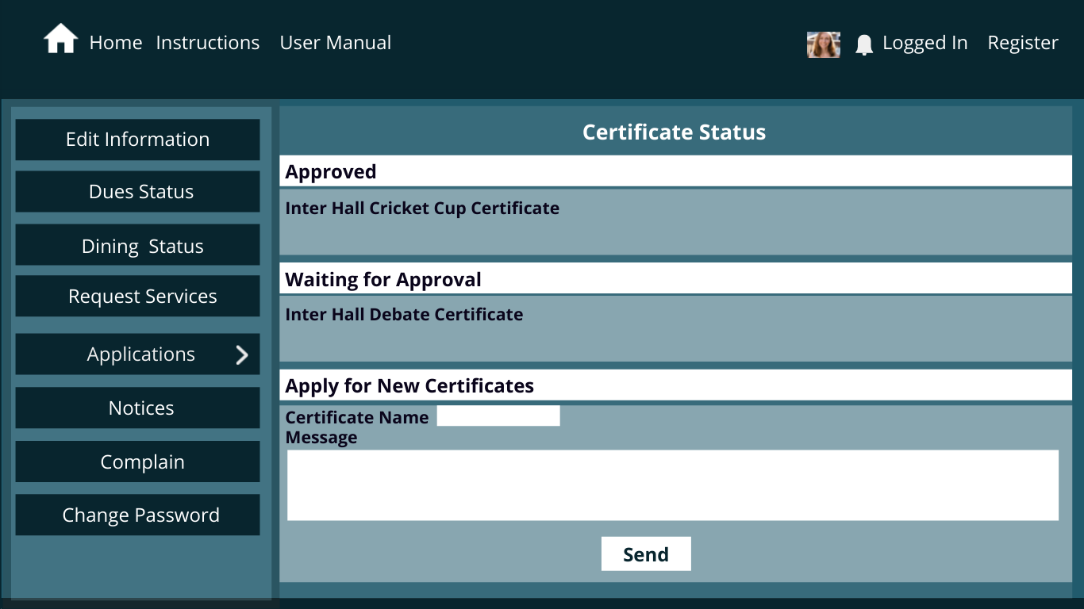
Student Applications

Slide 23
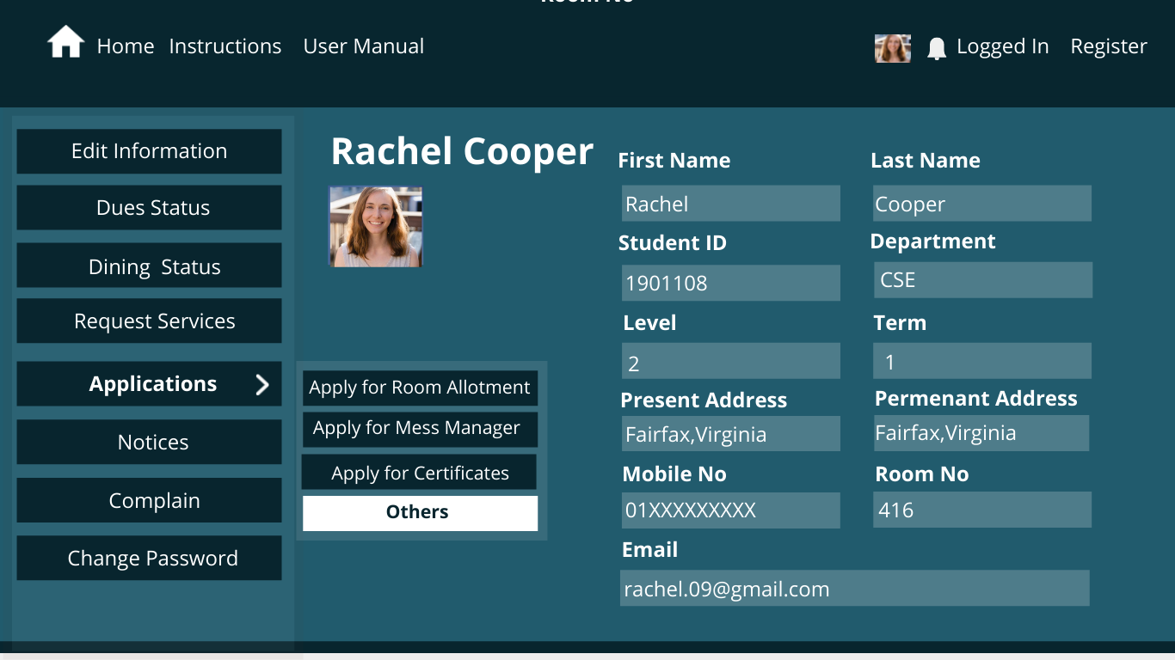
Student Applications

Slide 24
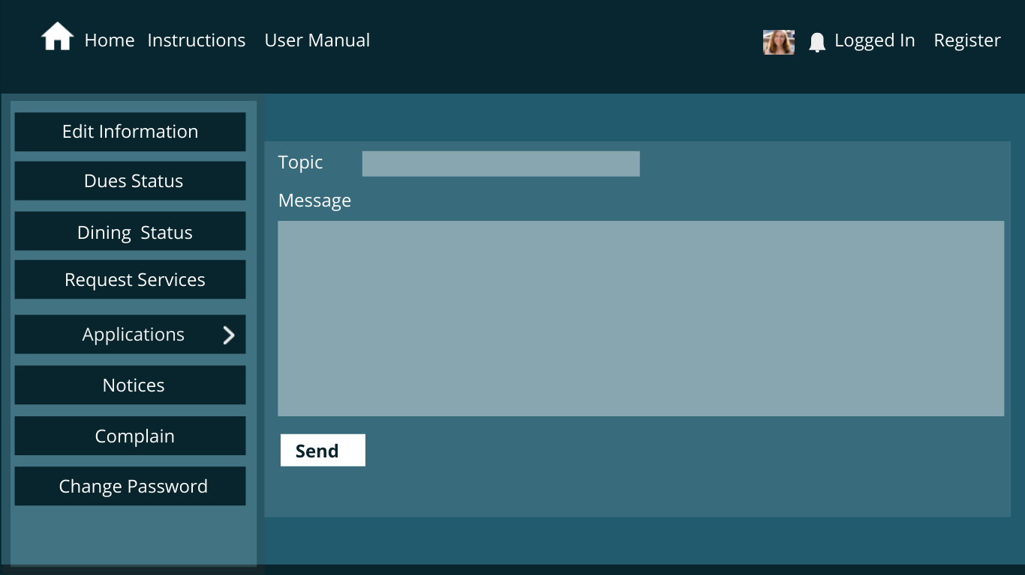
Student Applications

Slide 25
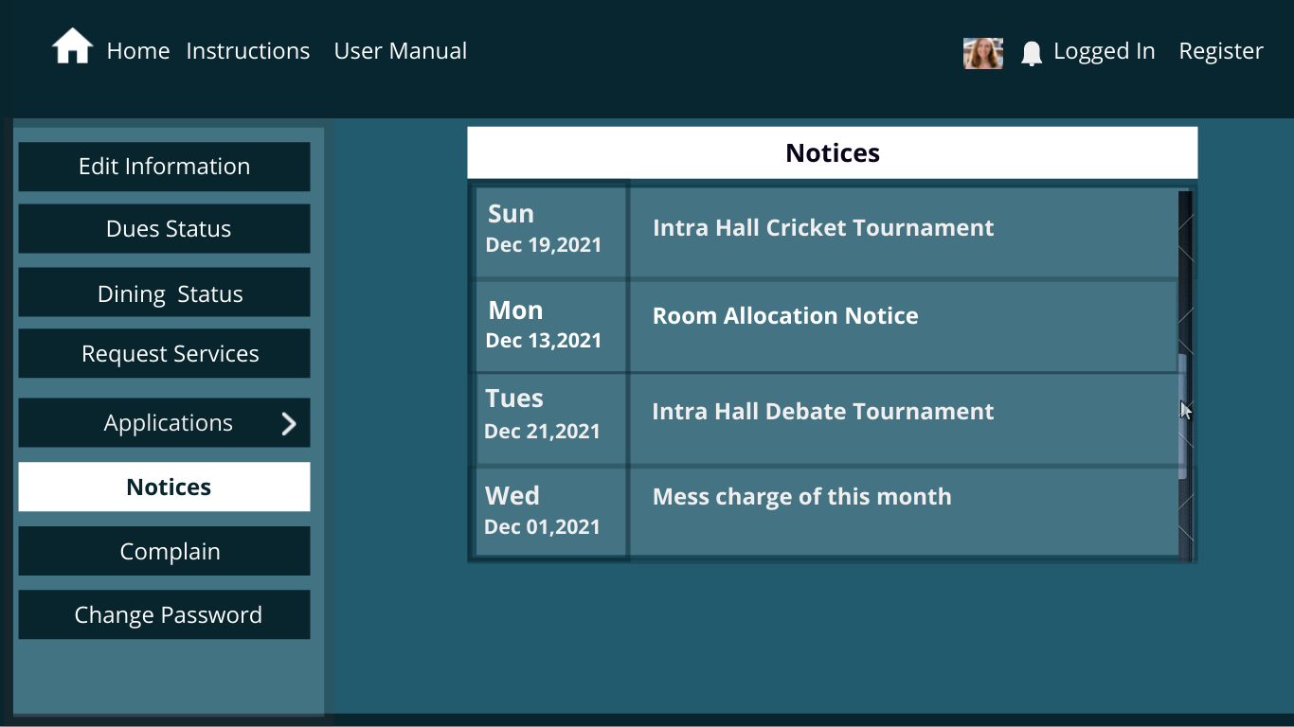
Notice Board

Slide 26
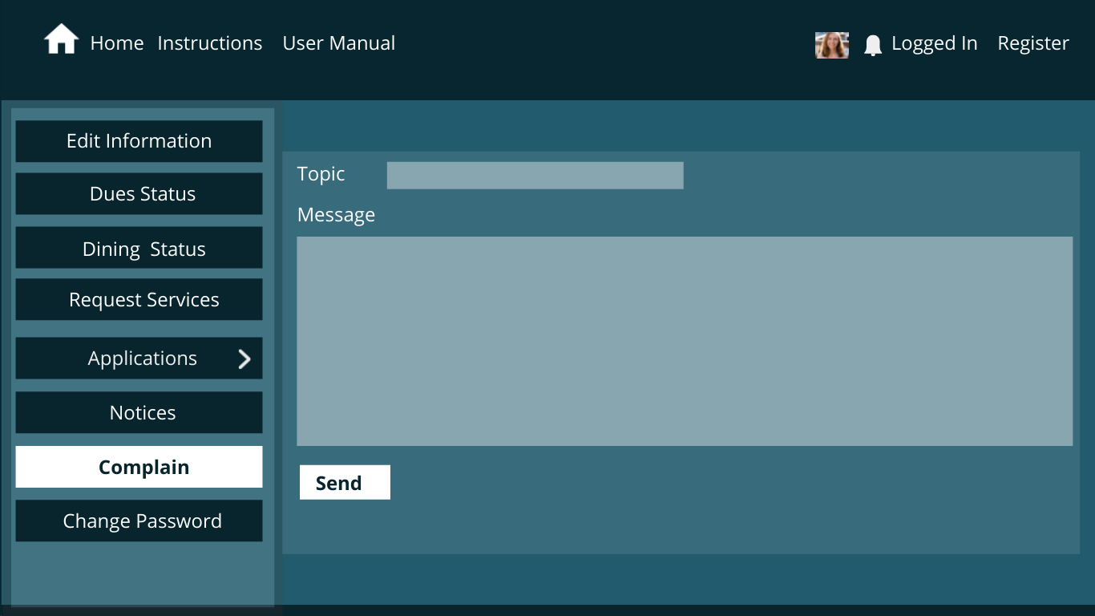
Complain Page

Slide 27
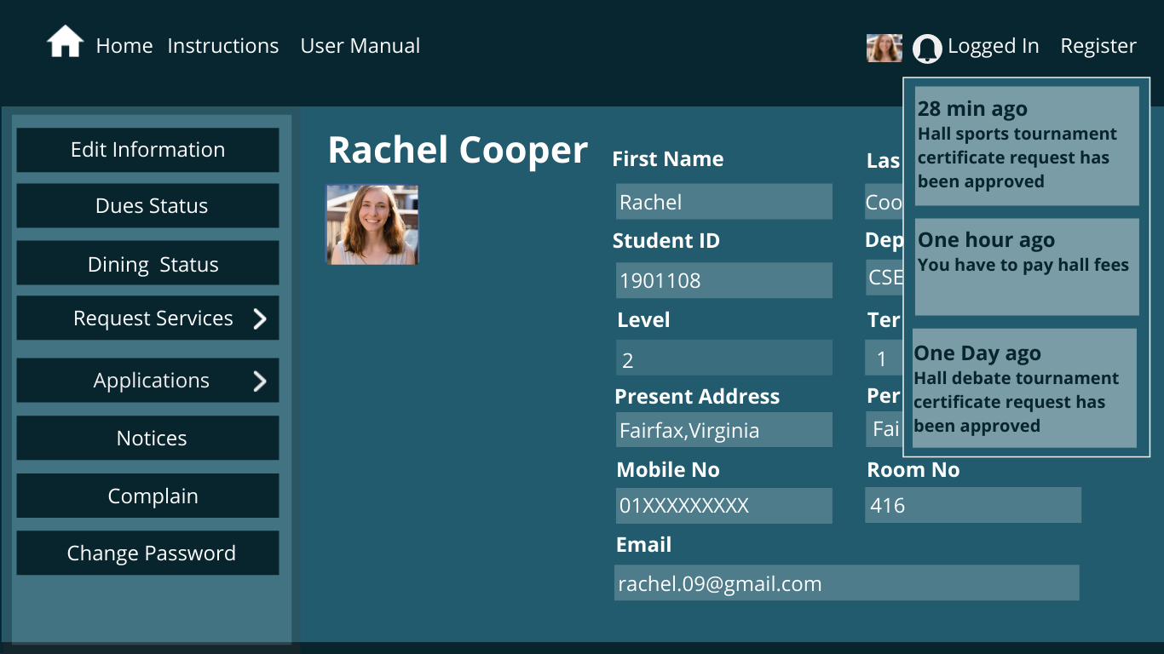
Notification Box

Slide 28
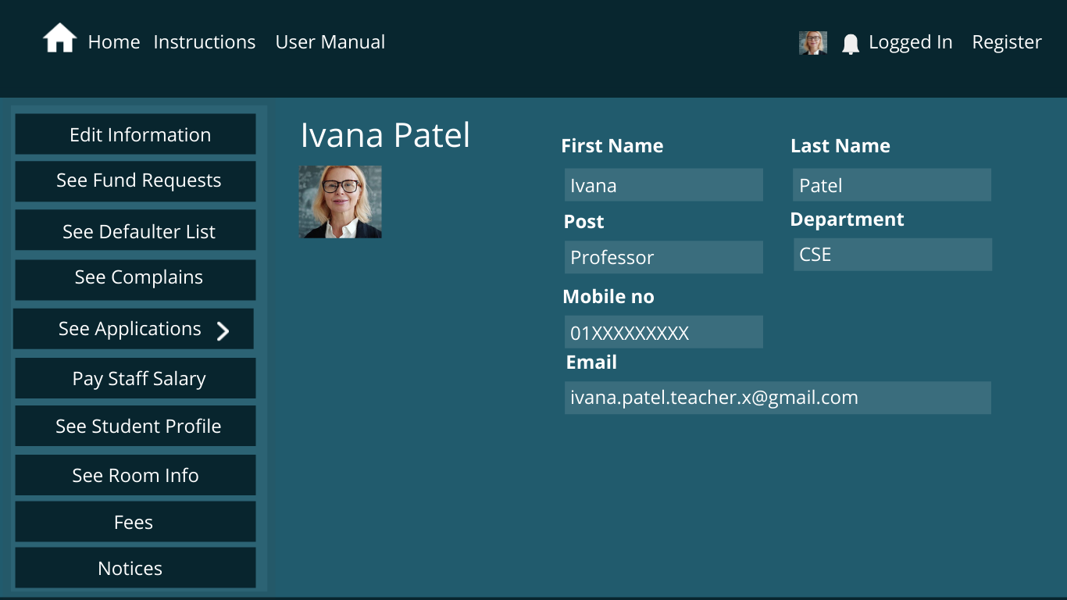
Provost Page

Slide 29
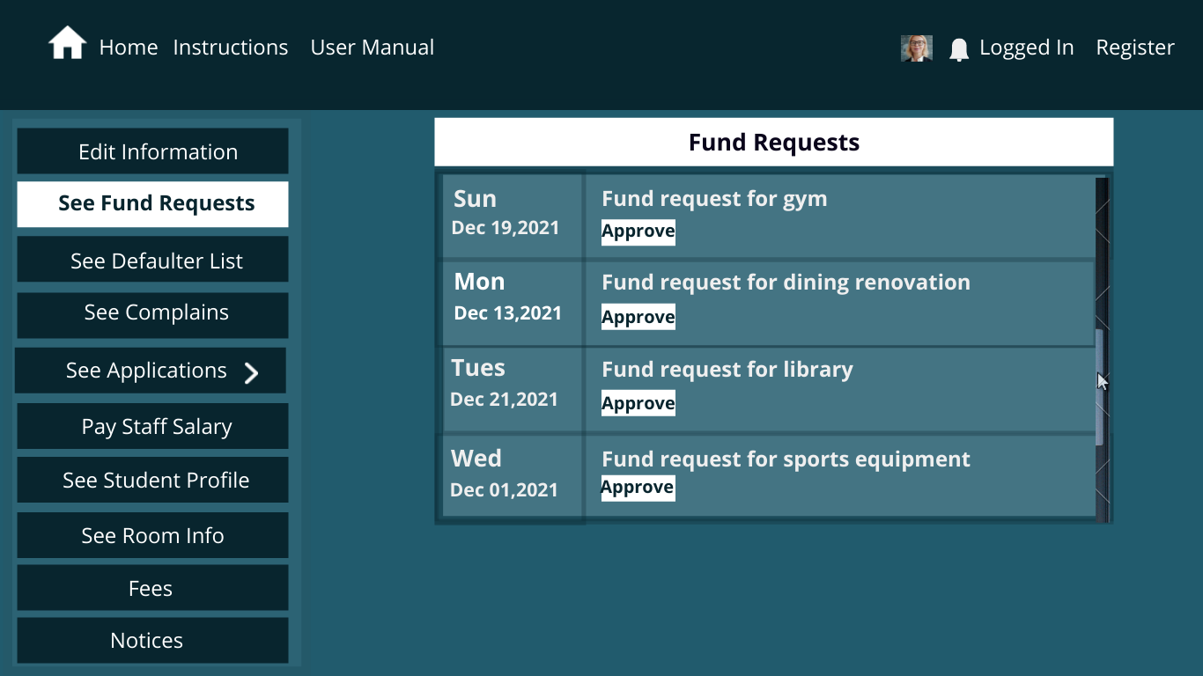
Fund Requests

Slide 30
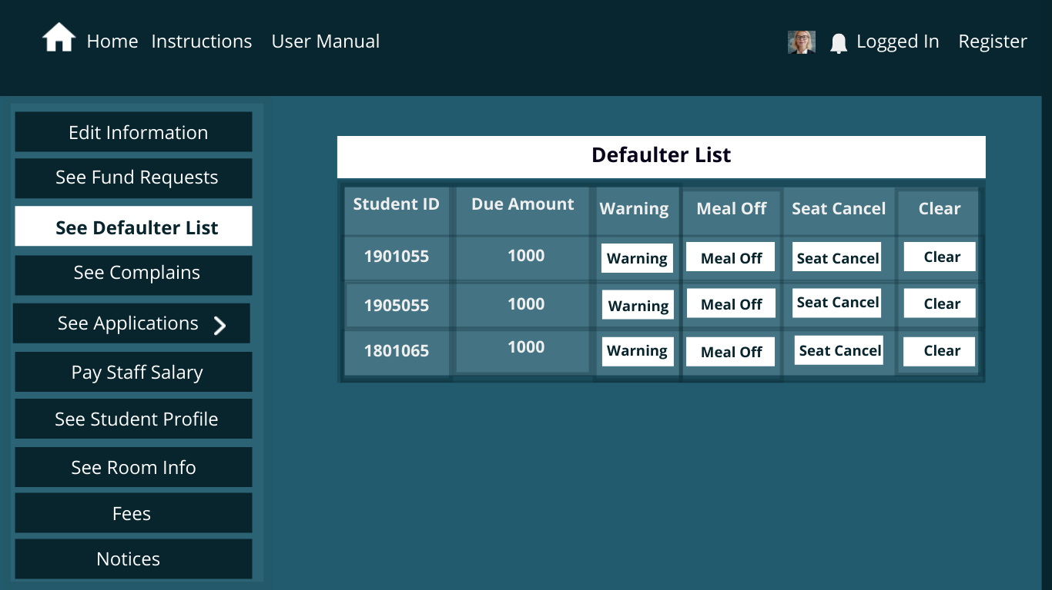
Defaulter List

Slide 31
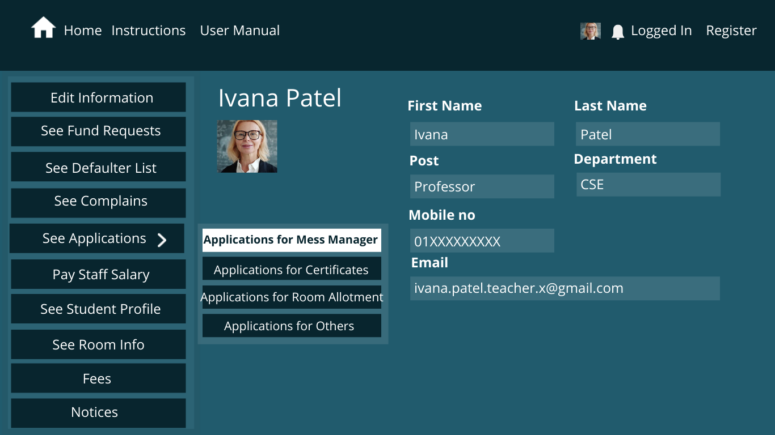
Provost Page

Slide 32
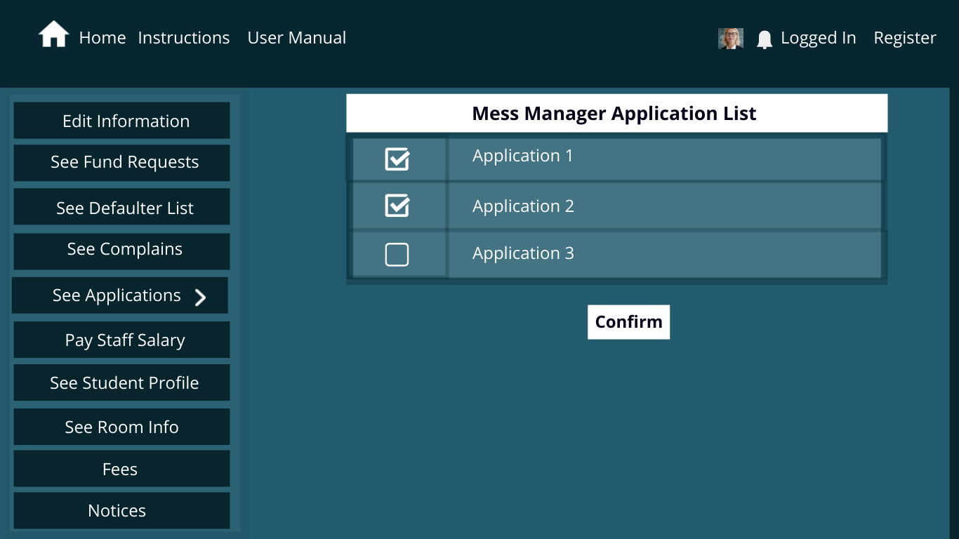
Mess Manager Applications

Slide 33
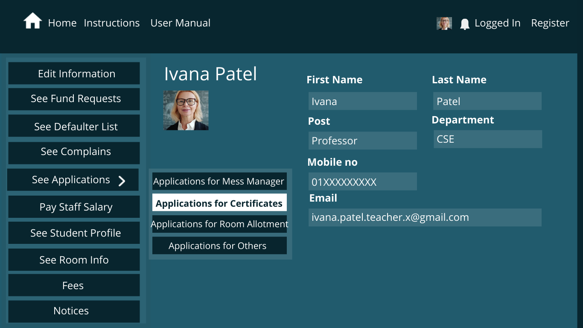
Provost Page

Slide 34
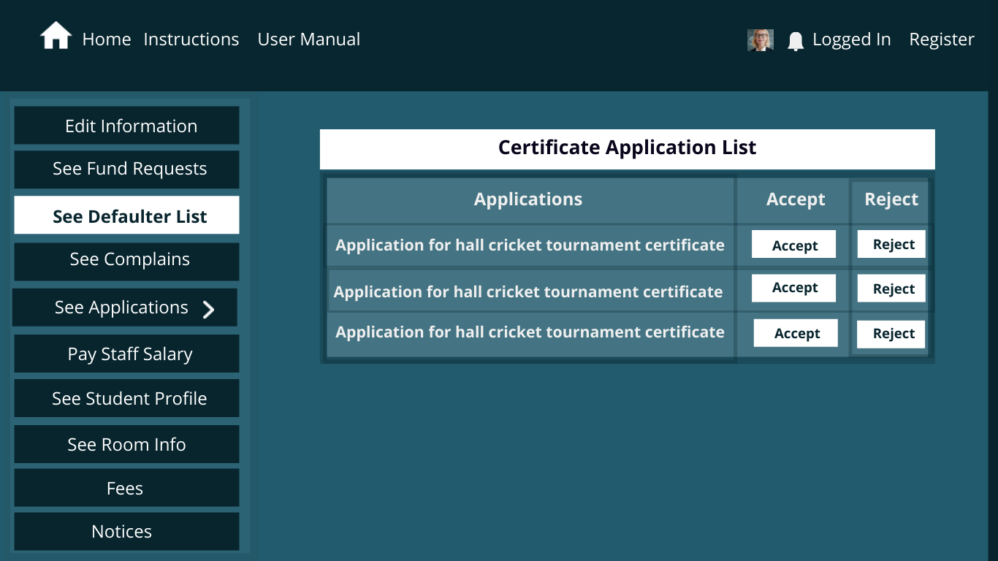
Certificate Applications

Slide 35
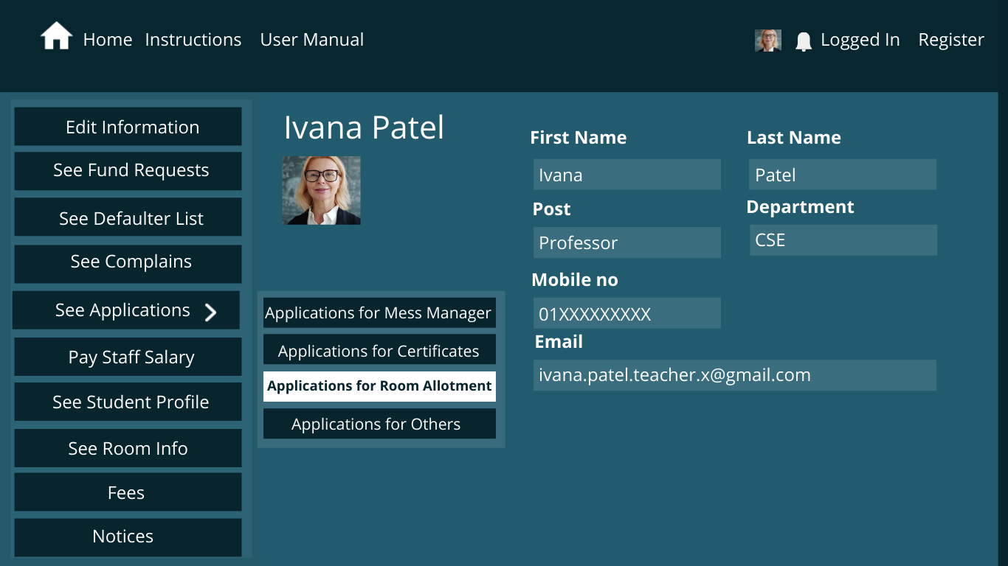
Provost Page

Slide 36
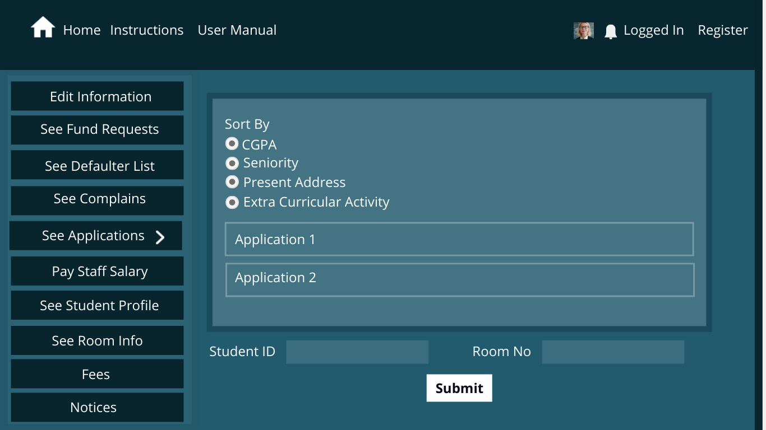
Room Allotment Application

Slide 37
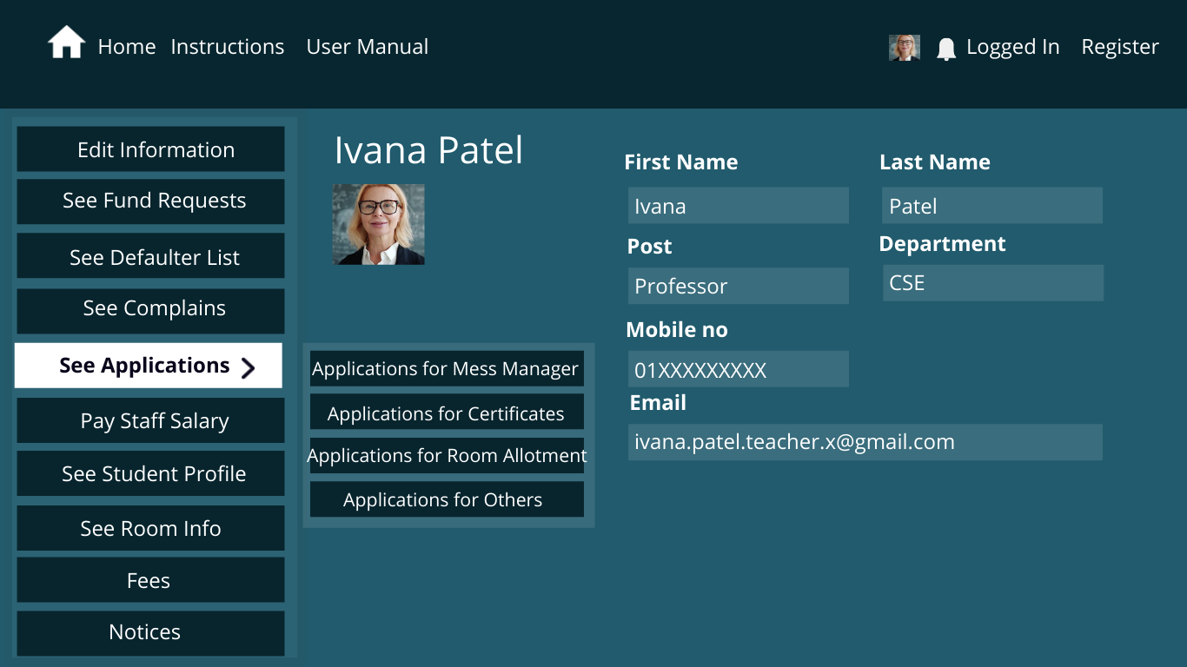
Provost Page

Slide 38
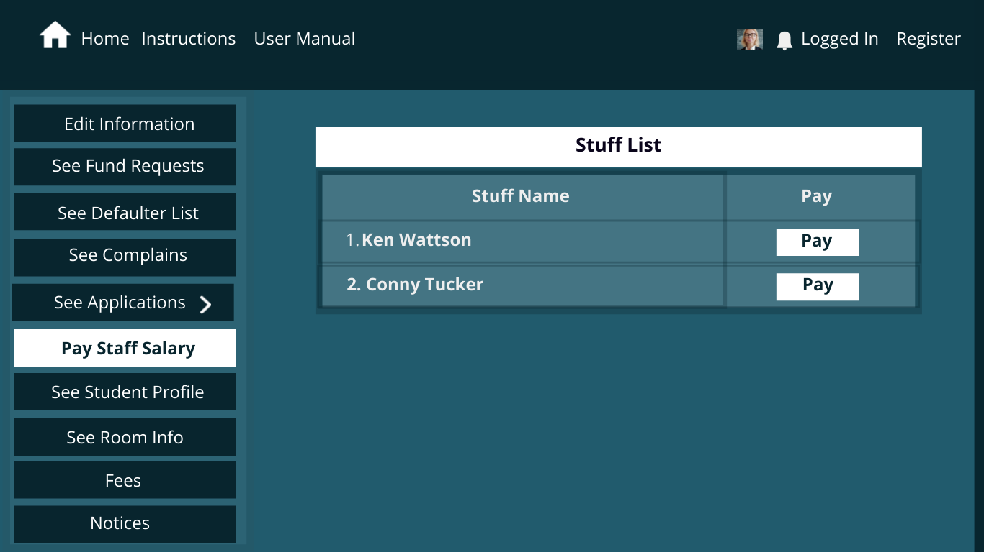
Pay Stuff Salary

Slide 39
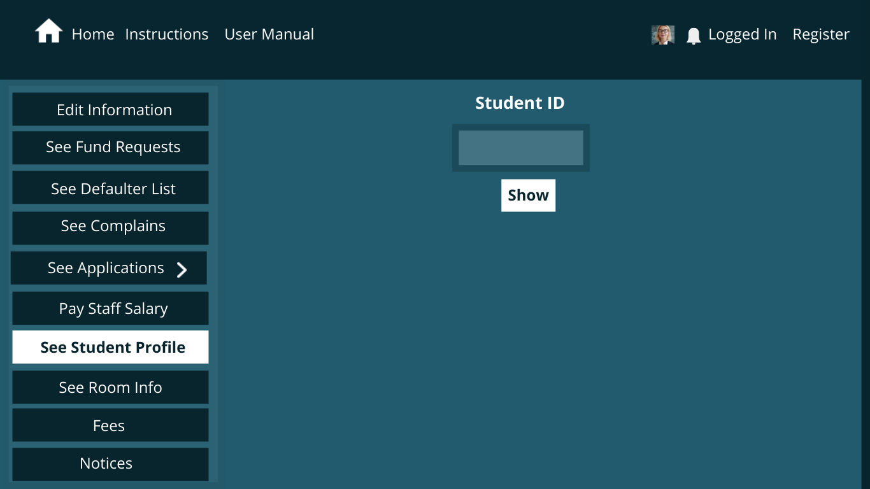
Student Profile Info

Slide 40
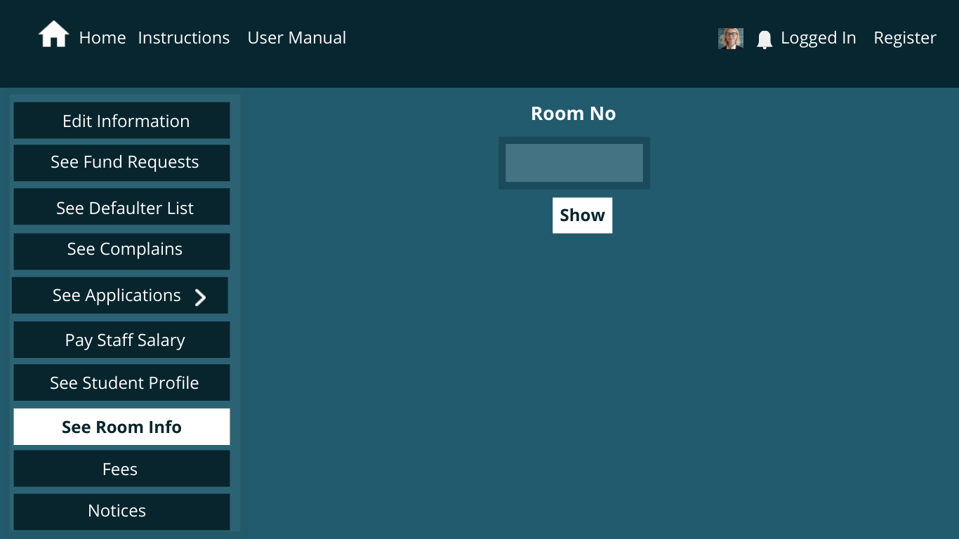
Room Info

Slide 41
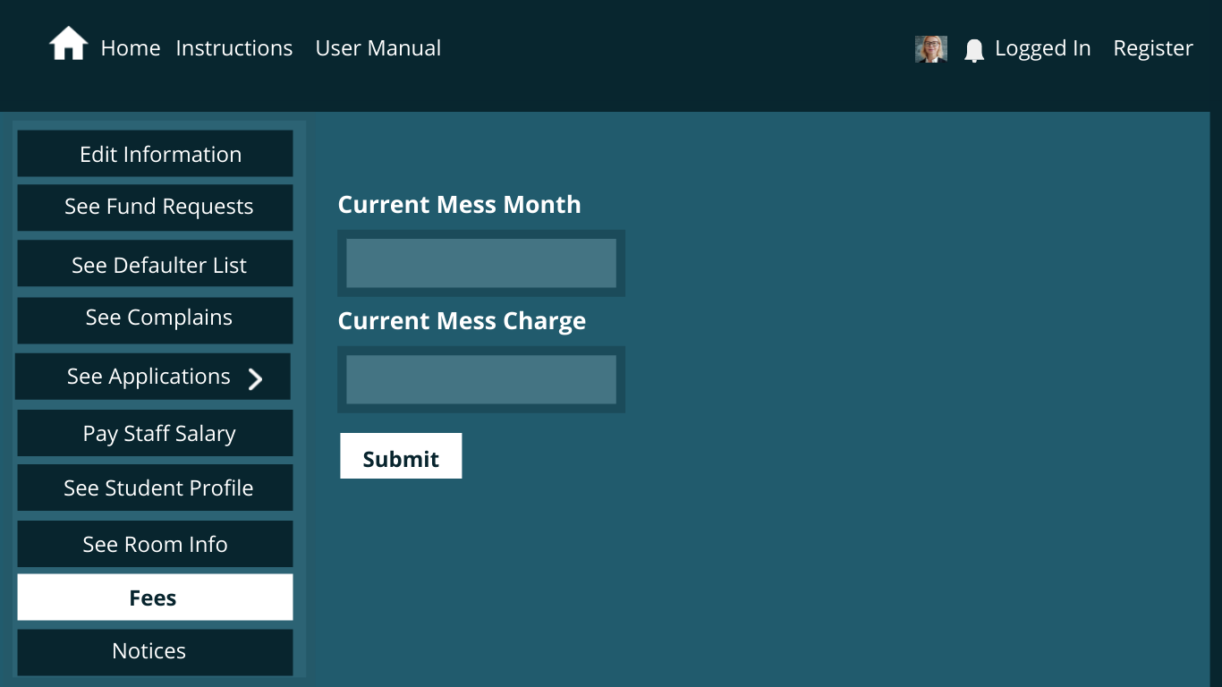
Fees

Slide 42
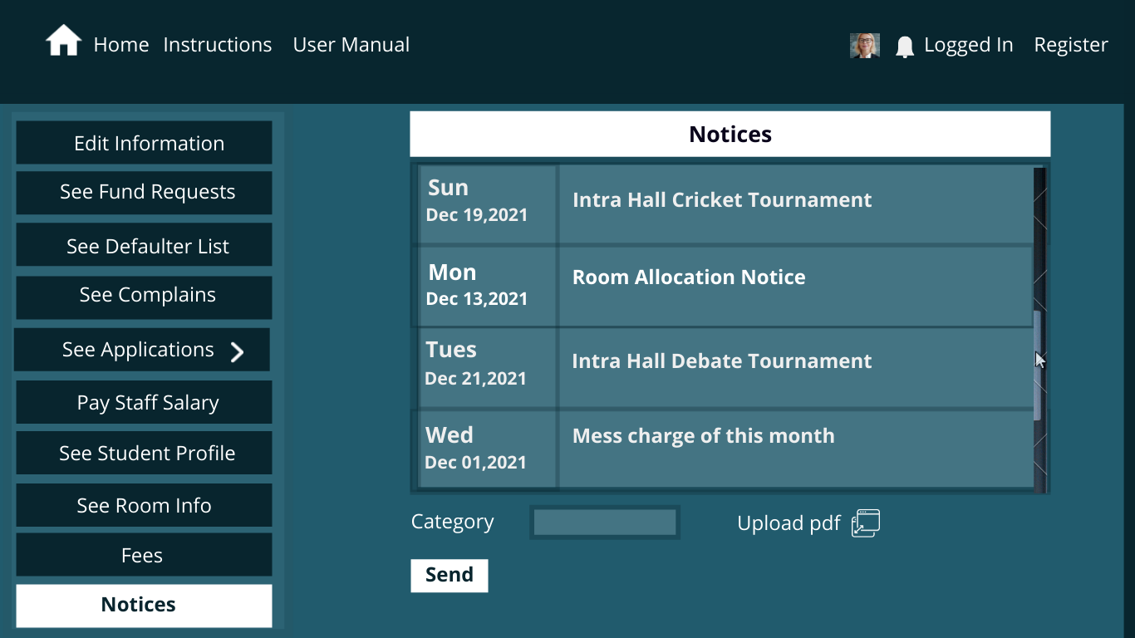
Notices

Slide 43
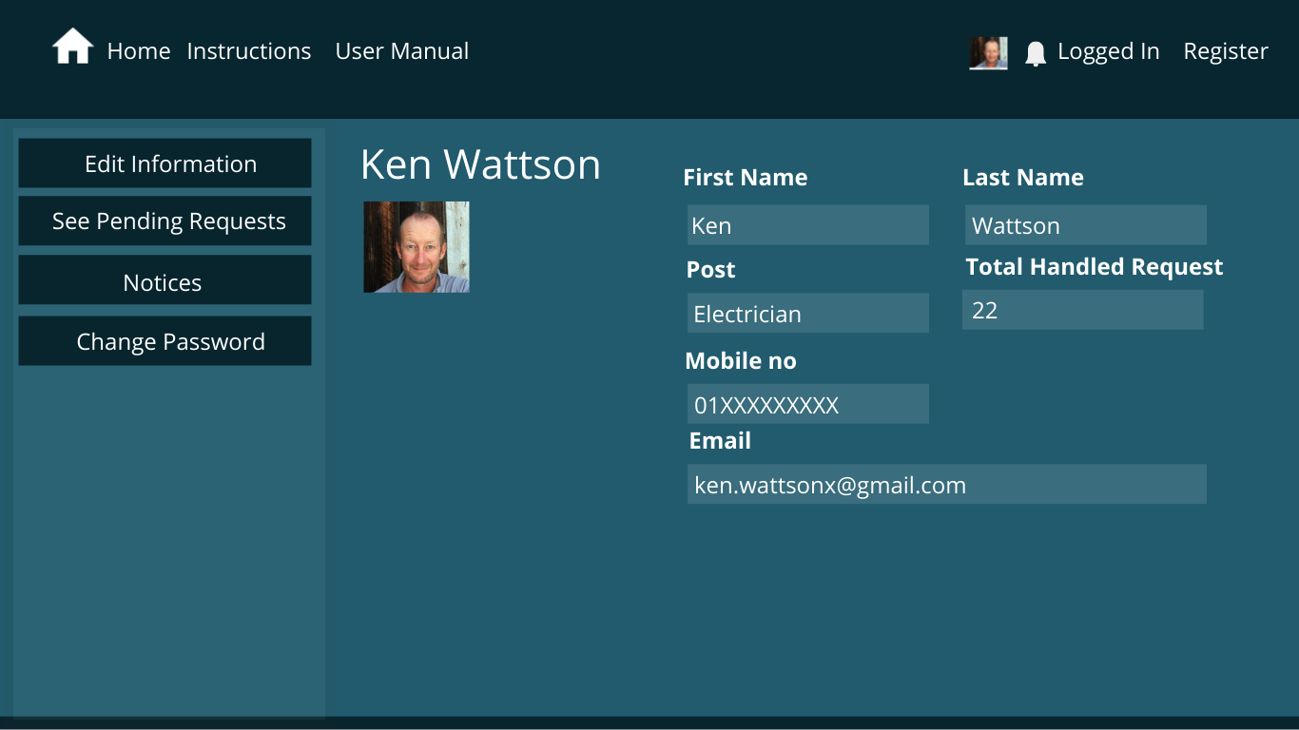
Office Staff Page

Slide 44
THANK YOU ALL

